Slide 1

History of Multimedia
(Revolutions in Communication and Advertising)
Valerie Thueson/ AM304/ December 6, 2018

Slide 2
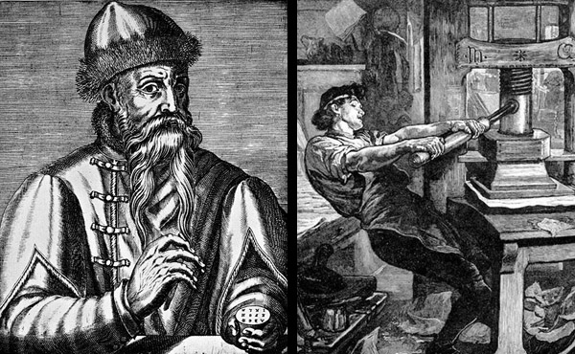
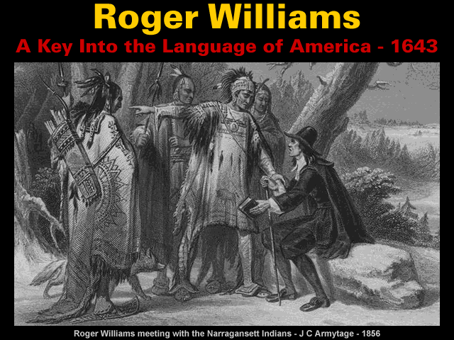
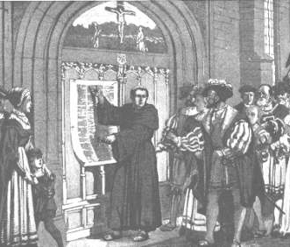
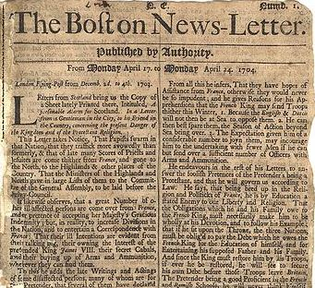
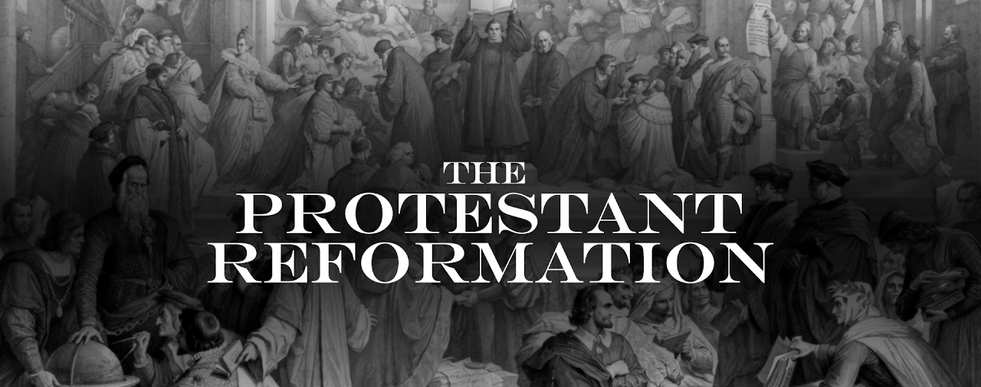
History of Multimedia (1400s-1700s)
(1605) First Newspaper
(1454)
Gutenberg Press
(1784) Bifocals
(1517) Martin Luther (Late 1400s-1500s)
(1604) First English Monolingual Dictionary
(1643) Roger Williams
(1604-1683)
(1663) First magazine which showed market for specific interests
(1657) First coffee ad
(1704) First American newspaper ad for real estate
Nailed his 95 Theses to the church door
“A Key Into the Language of America”
Protestant Reformation (1517 – 1648)
Enlightenment
(1715-1789)
Renaissance (1300s-1600)
Industrial Revolution
(1760-1840)
Age of Exploration & colonization (1400s-1700s)

Slide 3
History of Multimedia (1400s-1700s)
Gutenberg Press changes communication forever
Martin Luther and his 95 Theses pushes for religious freedom
First English Monolingual Dictionary helped build bridges for language
First Newspaper: printing presses used to spread news
“A Key Into the Language of America” spread knowledge of Native American culture
First coffee ad: claimed it helped with coughs, colds, and headaches
First literary and philosophy magazine: showed a market for specific interests
First American newspaper ad for real estate: ads in public news spreads

Slide 4
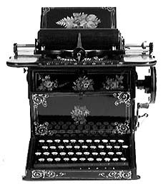
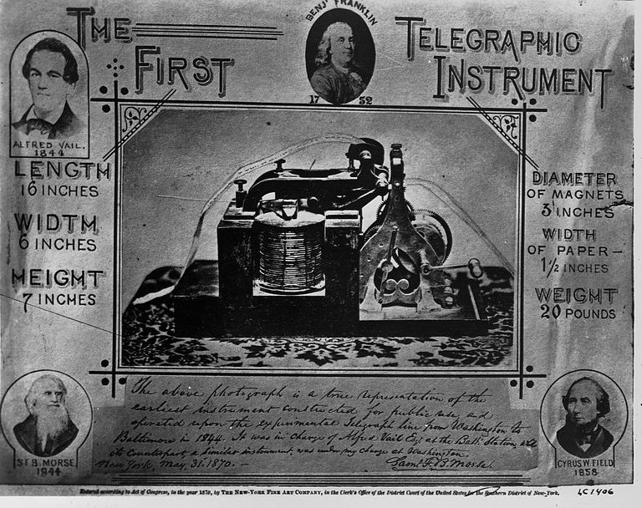
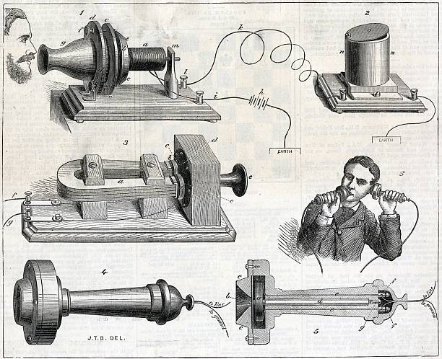
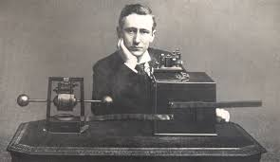
History of Multimedia (1800s)
(1858) Cyrus Field (1852-1880s)
(1837)
Telegraph Invented
(1839) Louis-Jacques-Mande Daguerre
(1822-1840s)
(1874)
First Successful Typewriter goes on sale
(1876) Telephone invented by Alexander Graham Bell
(1860)
Brady’s Portrait
of Lincoln
(1866) First Working Transatlantic Cable
(1879)
Light bulb invented
(1855)
Roger Fenton
(1850-1862)
Photographs
Crimean War
(1861-1865)
Matthew Brady
(1844-1896)
Photographs
Violence of war
(1863-1864)
Bergstresser Brothers took soldier photos
(1895)
Guglielmo Marconi
(1894-1932) invents radio communication
(1898)
Edward S. Curtis
(1892-1900s)
Photographs
Native American
Culture
Daguerreotype
Lays Transatlantic Cable and FAILS
Industrial Revolution
(1760-1840)
US Civil War (1861-1865)
Age of Nationalism (1850-1890)
Notes:
(1855) Roger Fenton

Slide 5
History of Multimedia (1800s)
1837: Telegraph allowed for communication/news to travel faster
1839: Daguerreotypes become foundation of photography
1855: Roger Fenton’s photos showed what war was like for soldiers
1858: Cyrus Field laid the transatlantic cable and failed (It’s okay to fail, if you keep going)
1860: Matthew Brady’s photo of Lincoln helped influence public opinion & the presidential election
1861-1865: Matthew Brady showed the violence behind war which helped bring up controversy over war
1863-1864: Bergstresser Brothers profited over families wanting pictures of soldiers

Slide 6
History of Multimedia (1800s cont.)
1866: Working Transatlantic cable allows for communication
1874: 1st successful typewriter goes on sale
1876: Alexander Graham Bell makes the telephone
1879: Light bulb invented by Thomas Edison using electricity
1895: Guglielmo Marconi (1894-1932) invents radio communication
1898: Edward S. Curtis wanders off from his studio and family to begin photographing Native Americans which shared an unknown culture from most Americans of the time

Slide 7
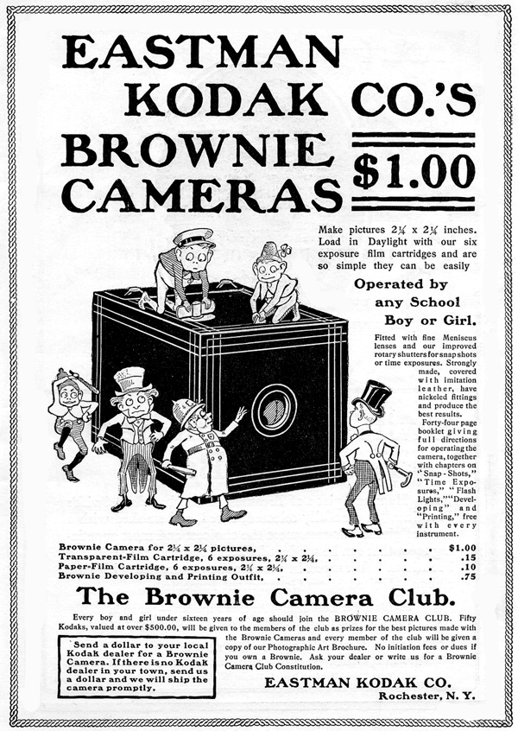
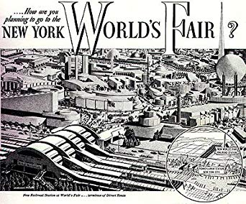
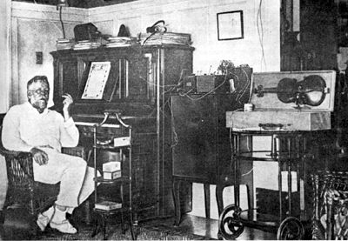
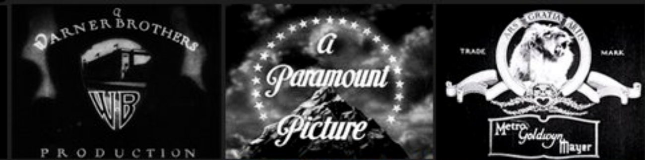
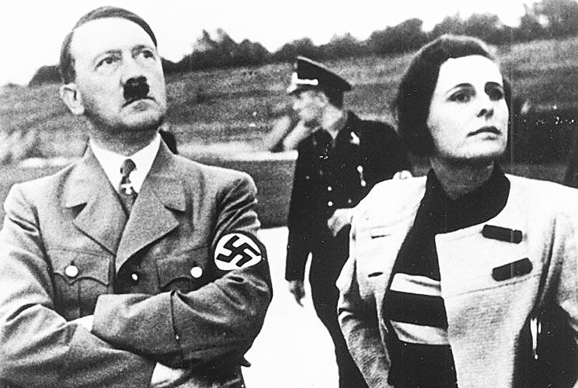
History of Multimedia (1900-1940)
(1900)
Kodak "Brownie" Camera
(1934)
Leni Rifenshal (1926-2000) Nazi Propaganda Films
(1906) Radio
available to
the public
(1927) First Electronic Television Prototype Created
(1922) F.W. Murnau (1908-1931) Directed Nosferatu
(1922) First Radio Cammerical AT&T's WEAF offers 10 mins for $100
(1930s) Studio Branding of MGM, Paramount, and WB
(1939) First Television Set Premiered at New Work World's Fair
WWII
(1939-1945)
WWI
(1914-1918)
Golden Age of TV
(1940s-1960s)
Golden Age of Radio
(1930s-1940s)
Golden Age of Film (1920s-1960s)
Notes:
(1855) Roger Fenton

Slide 8
History of Multimedia (1900-1940)
1900: Kodak “Brownie” Camera allows for the public to take photos on their own
1906: Radio publicly available which creates a whole new outlet for news and ads
1922: First Radio Commercial AT&T's station WEAF in New York offers 10 minutes of radio time to anyone who would pay $100
1922: Nosferatu influenced horror cinema and influenced the commercialization of Dracula
1927: First Electronic Television Prototype were the first steps towards television today
1930s: Studios Branding, MGM, Paramount, and Warner Brothers all started to become known for the different looks their films had (Glossy, Hard Edge, and Glamour)
1934: Leni Riefenshahl German director who filmed the Nazi Nuremberg rally for Hitler and was acclaimed as a Nazi supporter later since she made propaganda films.
1939: First Television Set Premiered at the New York World’s Fair

Slide 9

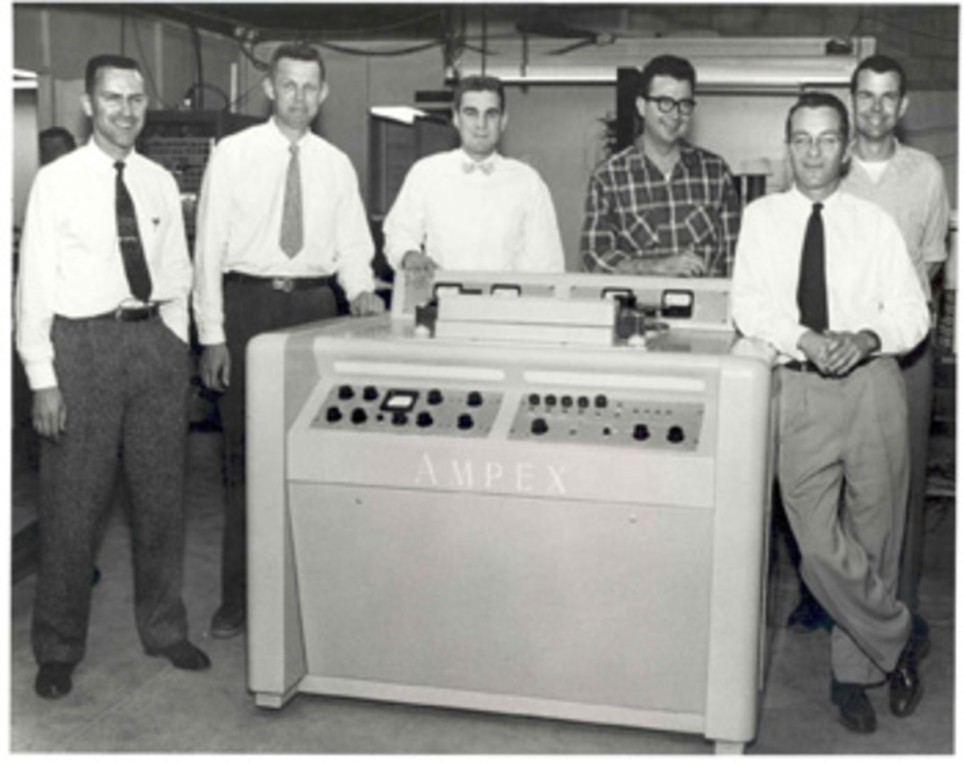
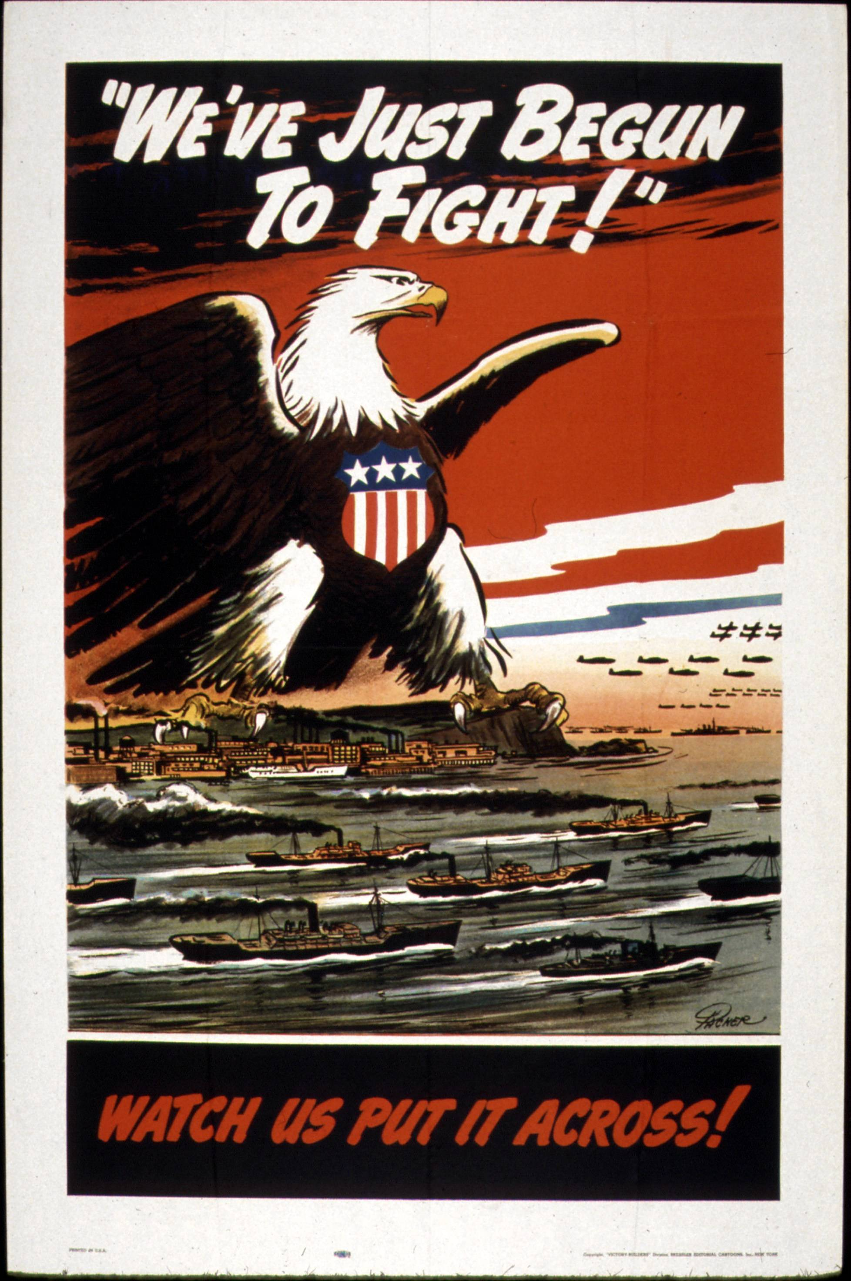
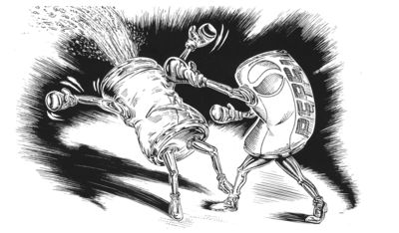
History of Multimedia (1940-2000)
(1942)
OWI War
(1949) Fairness Doctrine: demand for balanced broadcasting
(1950) Joseph McCarthy (1940-1954)
(1984) Apple 1984
(1995) eBay Founded
(1995) Craigslist Founded
(1956)
Videotape recordings
make commercials
possible
(1975)
First Personal Computer:
Altair 8800
(1983)
ARPANET adopts
TCP/IP=Internet
(1963)
Cola Wars
Propoganda
Super bowl
Commercial
(1961)
Newton Minow
(1961-1963)
“Vast Wasteland” Speech
(1996) John Perry Barlow
"Declaration of Independence of Cyberspace"
McCarthyism
Vietnam War (1955-1975)
WWII
(1939-1945)
Cold War (1947-1991)
Golden Age of TV (1940s-1960s)
Golden Age of TV (1940s-1960s)
Age of Computers or Information Age (1970s-21st Century)
Golden Age of Film (1920s-1960s)
Age of Internet(1989-21st Century)
Notes:
(1855) Roger Fenton

Slide 10
History of Multimedia (1940-2000)
1942: Office of War Information (OWI) in charge of disseminating war propaganda
1949: Fairness Doctrine required those with broadcasting licenses to discuss controversial issues in an honest and balanced way that the FCC would determine as fitting, especially hard with tobacco advertising
1950: McCarthyism: Joseph McCarthy accused US Department of State members of being part of the Communist Party
1956: Videotape recording makes prerecorded commercials possible
1961: Newton Minow’s referred to commercial television programming as a “vast wasteland”
1963: "The Pepsi Generation" kicks off the cola wars (Pepsi vs. Coke)

Slide 11
History of Multimedia (1940-2000 cont.)
1975: First personal computer starts foundation for public using computers
1983: TCP/IP network the basis for the internet
1984: Apple 1984 Super Bowl Commercial combined their technology and George Orwell’s 1984 novel to show how great Apple computer would be
1995: eBay, E-commerce corporation founded by Pierre Omidyar to facilitate one-on-one sales between online users and businesses
1995: Craigslist, online classified ad website created by Craig Newmark for public use for buying and selling as well as gigs, community happenings, and discussion forums.
1996: John Perry Barlow wrote “Declaration of the Independence of Cyberspace” calling for free speech online and less internet restrictions

Slide 12


History of Multimedia (2000s)
(2003)
Streisand Effect
(2004)
Facebook
(2008)
App Economy
(2001)
Wikipedia
(2007)
Twitter
Age of Computers or Information Age (1970s-21st Century)
Golden Age of TV (1940s-1960s)
Age of Internet(1989-21st Century)
Notes:
(1855) Roger Fenton

Slide 13
History of Multimedia (1940-2000 cont.)
2001: Wikipedia’s open source format has allowed for public collaboration on any topic
2003: Streisand effect: attempt to hide, remove, or sensor a piece of information and ends up with that information being further publicized by use of the Internet after Barbara Streisand’s court issue of her house being seen over the internet
2004: Facebook invented Social networking and media site created by Mark Zuckerberg for online users to post comments, share photos, post links, and content via the internet
2007: Twitter made for group planning and led to social media craze that also became an outlet for ads, news, and emergencies
2008: App Economy starts with the ease of technological advancements for phones that allowed for greater videos, interactivity, and social media

Slide 14
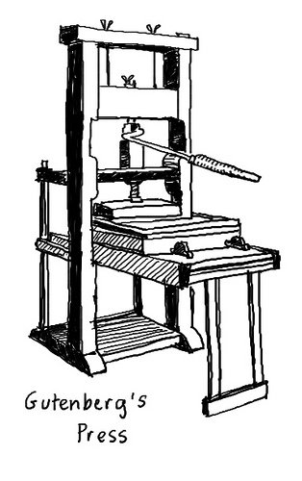
SO IT GOES…
TO BE CONTINUED… FOREVER.

